Slide 1







Evaluating Private Technologies and Implementations

Slide 2



Who Am I?
Justin Ehrenhofer
Organizer of the Monero Community Workgroup and the Monero Malware Response Workgroup
Board Member of MAGIC (https://magicgrants.org)
Previous experience in cybersecurity
Interested in distributed privacy systems
Senior moderator of r/CryptoCurrency with over 750,000 subscribers

Slide 3
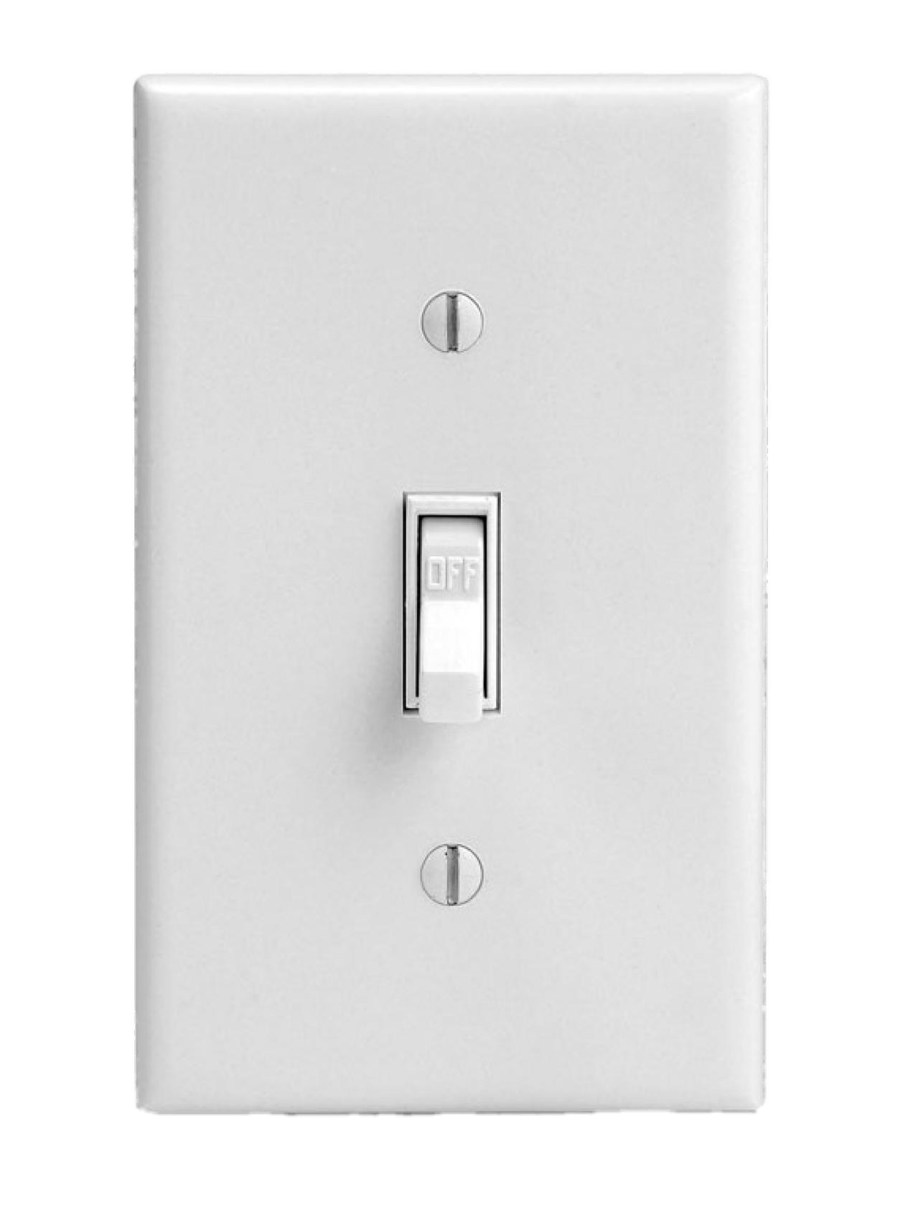
Privacy Isn’t Binary
What most people think privacy is:

Slide 4
Privacy Isn’t Binary
What privacy actually is:
Perfect Privacy
Perfect Transparency

Slide 5

Riccardo “fluffypony” Spagni Monero Core Team Member
Privacy isn’t a thing that you achieve, it’s a constant cat-and-mouse battle.
Notes:
https://www.wired.com/story/monero-privacy/

Slide 6

It All Comes Back to a Threat Model
Image courtesy of EFF

Slide 7
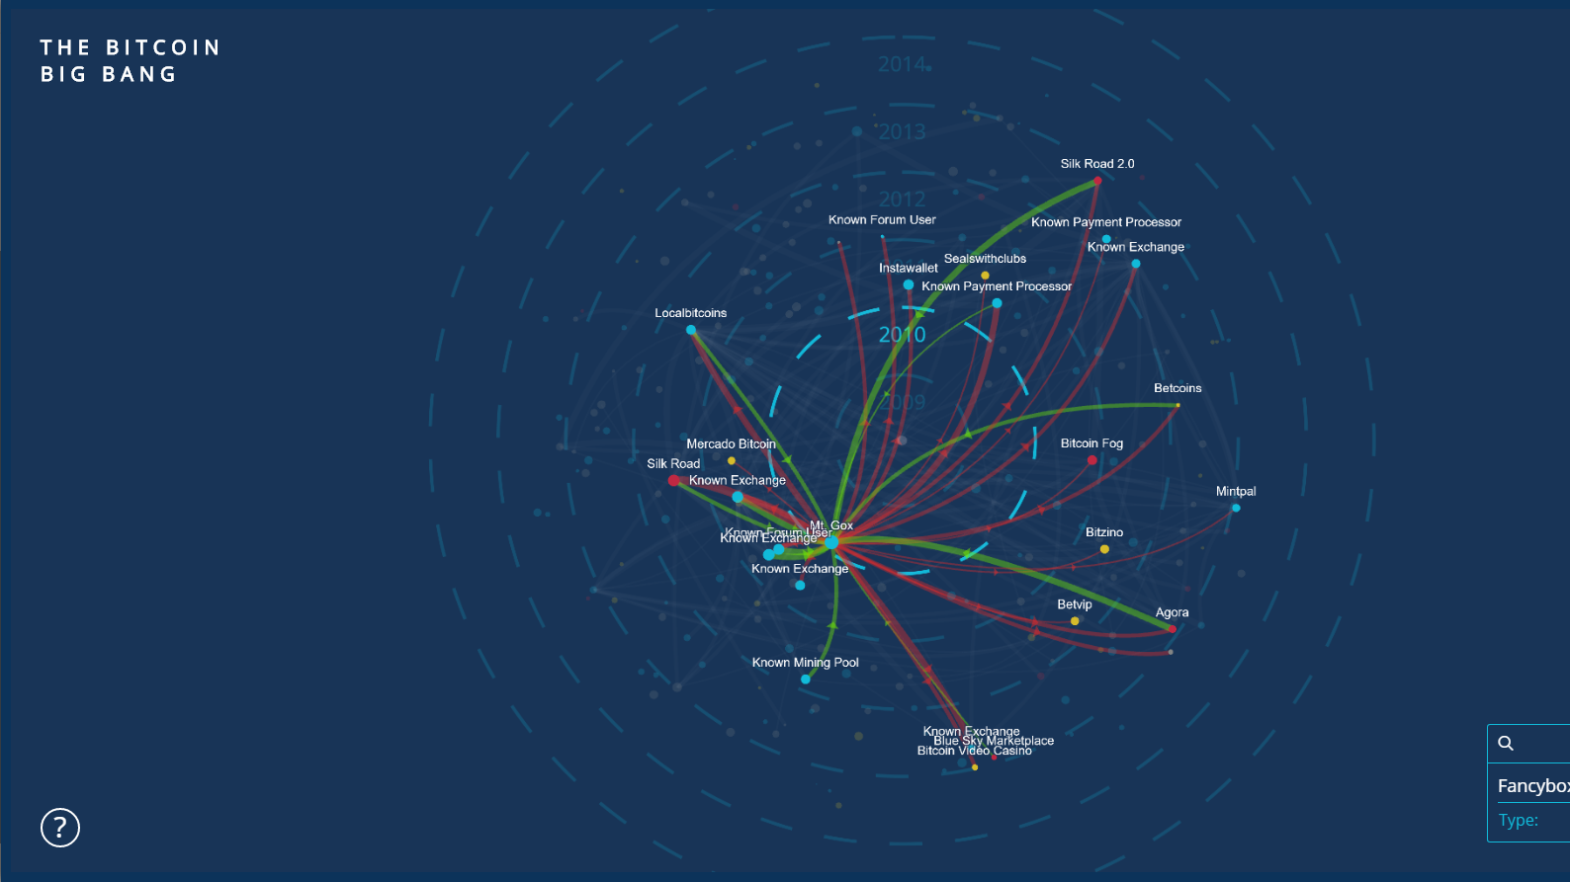

Bitcoin is NOT (very) private!
Notes:
Bitcoin is not private! In fact, it is perhaps the most transparent money system ever made. Everyone in the world can see a history of the following:
The amount of money in a wallet
Where the Bitcoin came from
Where the Bitcoin went
This visualization shows the transfer of Bitcoin from large accounts to others. It is a visual representation of transfers of Bitcoin.

Slide 8

Transparency Has Implications on People and Business
Sources
Expenses
$
Balances
Employer info
Family and friend connections
Business suppliers and upstream business connections
Fungibility
Political and religious affiliations
Health data and doctors
Customers and downstream business connections
Everyday purchasing habits
Employees
How much money you have
Targeted crime against wealthy individuals and companies, especially in cases of malware and robbery
Willingness to pay suppliers and charge customers
Willingness to pay employees

Slide 9
Tools Can Be Added to Transparent Systems. Their Effectiveness is Complicated
Probably not; it’s complicated
MIXER
TUMBLER
zkSNARK
zkSTARK
Highly transparent
Could be effective

Slide 10




Mixing Isn’t Very Effective
Notes:
When people started realizing that Bitcoin is not private, they tried adding things on top of Bitcoin so some people could have privacy. This is traditionally done with a Bitcoin mixing or CoinJoin approach. Several people take their Bitcoin and send it to a centralized server. This centralized server then gives a random Bitcoin from among those received back to the users. Ideally, this could provide some untraceability, since the origin of the received funds is ambiguous. However, there are several fundamental issues with this type of approach.

Slide 11
Mixing Isn’t Very Effective
Notes:
The vast majority of people who use an optional system that costs extra which you need to go out of your way to use are people who have tainted coins. Tainted coins are coins that are known to previously be used for illicit purposes. An insignificant number of people pay money to mix clean coins. Thus, mixers do not work very well at providing plausible deniability. Instead, they make you stand out, since it makes it look like you are doing something wrong. Mixing itself is a shady act.

Slide 12
Mixing Isn’t Very Effective
Notes:
Second, you add a level of trust to the system. While Bitcoin is trustless, you need to trust the mixer you use with CoinJoin. They may choose to keep a history of the transaction information, and the people who use the service will never know. People must trust that the mixer does not act maliciously, which is a systemic risk with mixing services. In an ideal private system, you should not have to trust anyone else with your privacy.
Finally, from a convenience perspective, it takes a long time to mix coins, since you need to wait for other participants to mix with. If you plan to mix a large number of coins several times, it can take days or weeks. Few users will go through this effort.

Slide 13
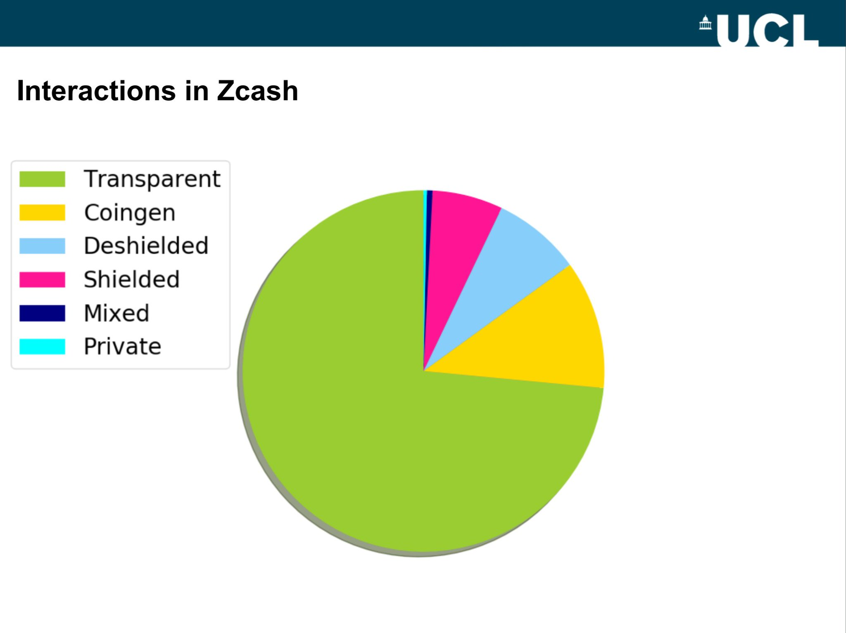
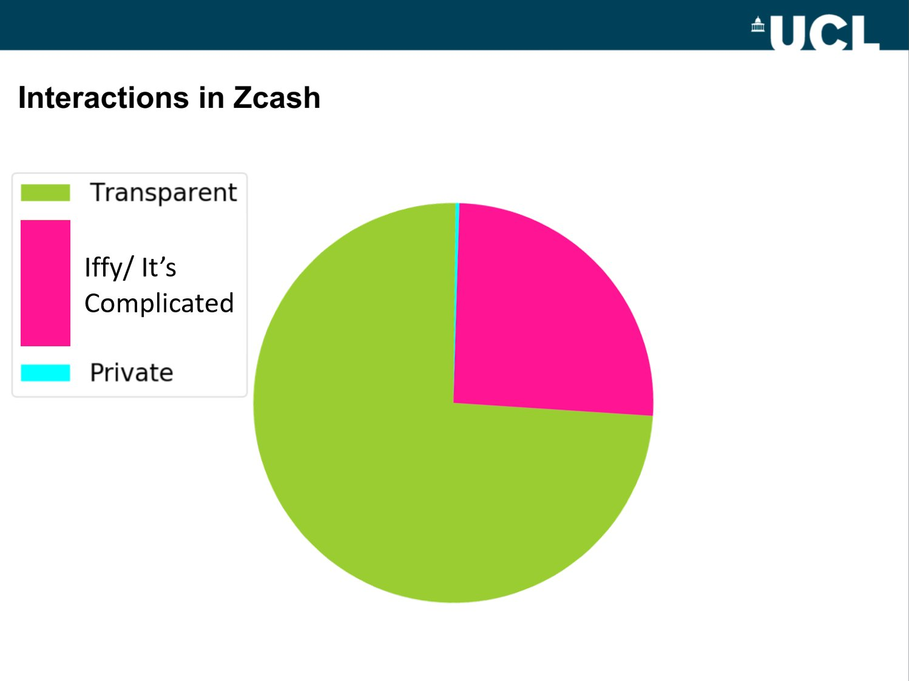
Effectiveness of Optional Extremely Private Systems is Complicated
Sprout: ~0.5% fully-shielded; Sapling: ~0.6% fully-shielded

Slide 14

Even Mandatory Privacy Isn’t Perfect
Some things Monero has done to increase its privacy in the last few months:
Increase ringsize from
Mandatory ringsizes
Better remote node metadata protection
Blackball tool
Churning recommendations
3
5
7
11

Slide 15
Zero-Knowledge Does Not Mean Perfect
Monero
Ring signatures are not perfect
Payment IDs are messy
Zcash
Turnstile migration process is difficult, likely impossible
Sapling introduces more output metadata
Both
Some output metadata
Timing attacks

Slide 16



Privacy Matrix
Accessibility & Usability
Theoretical Maximum Privacy

Slide 17
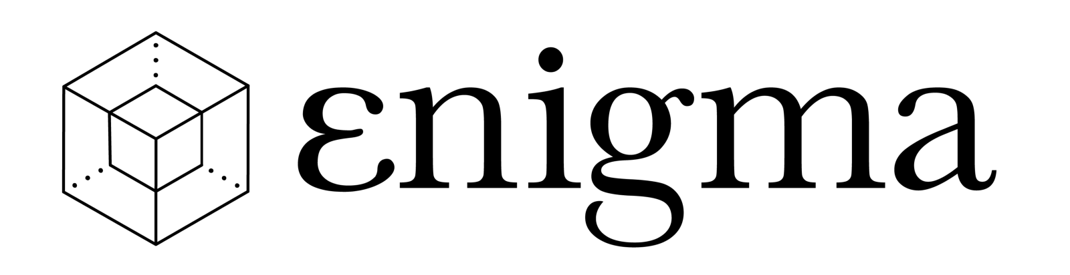

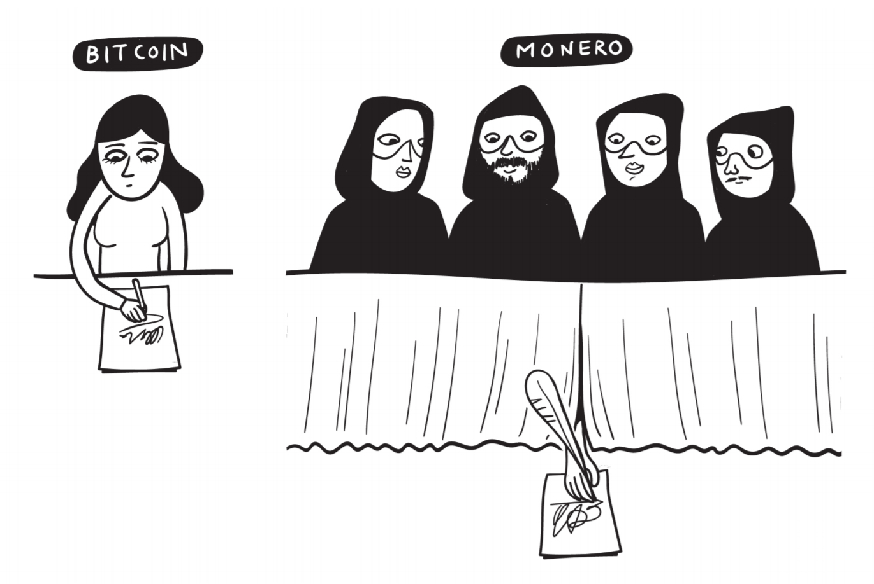
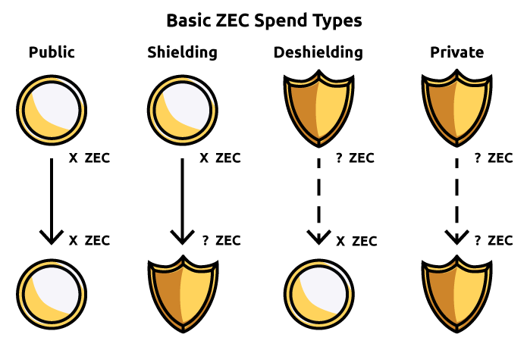
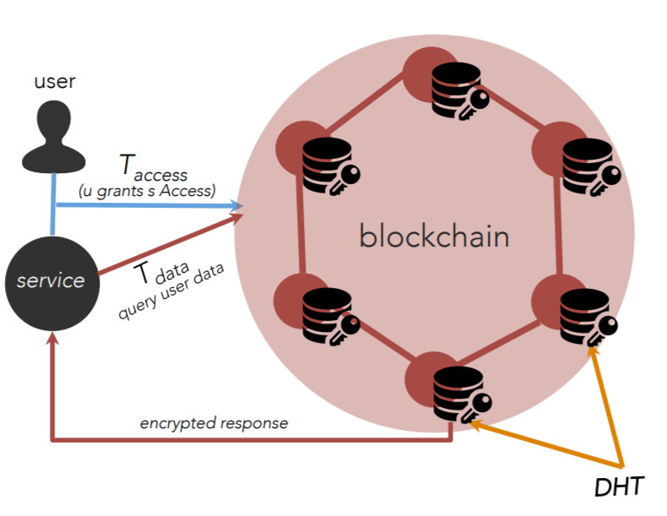
Privacy Solutions to Consider
Coming SoonTM
Ring signatures
RingCT
Stealth addressess
File encryption on central server
Hash stored on blockchain
zkSNARKs
zkSTARKs

Slide 18
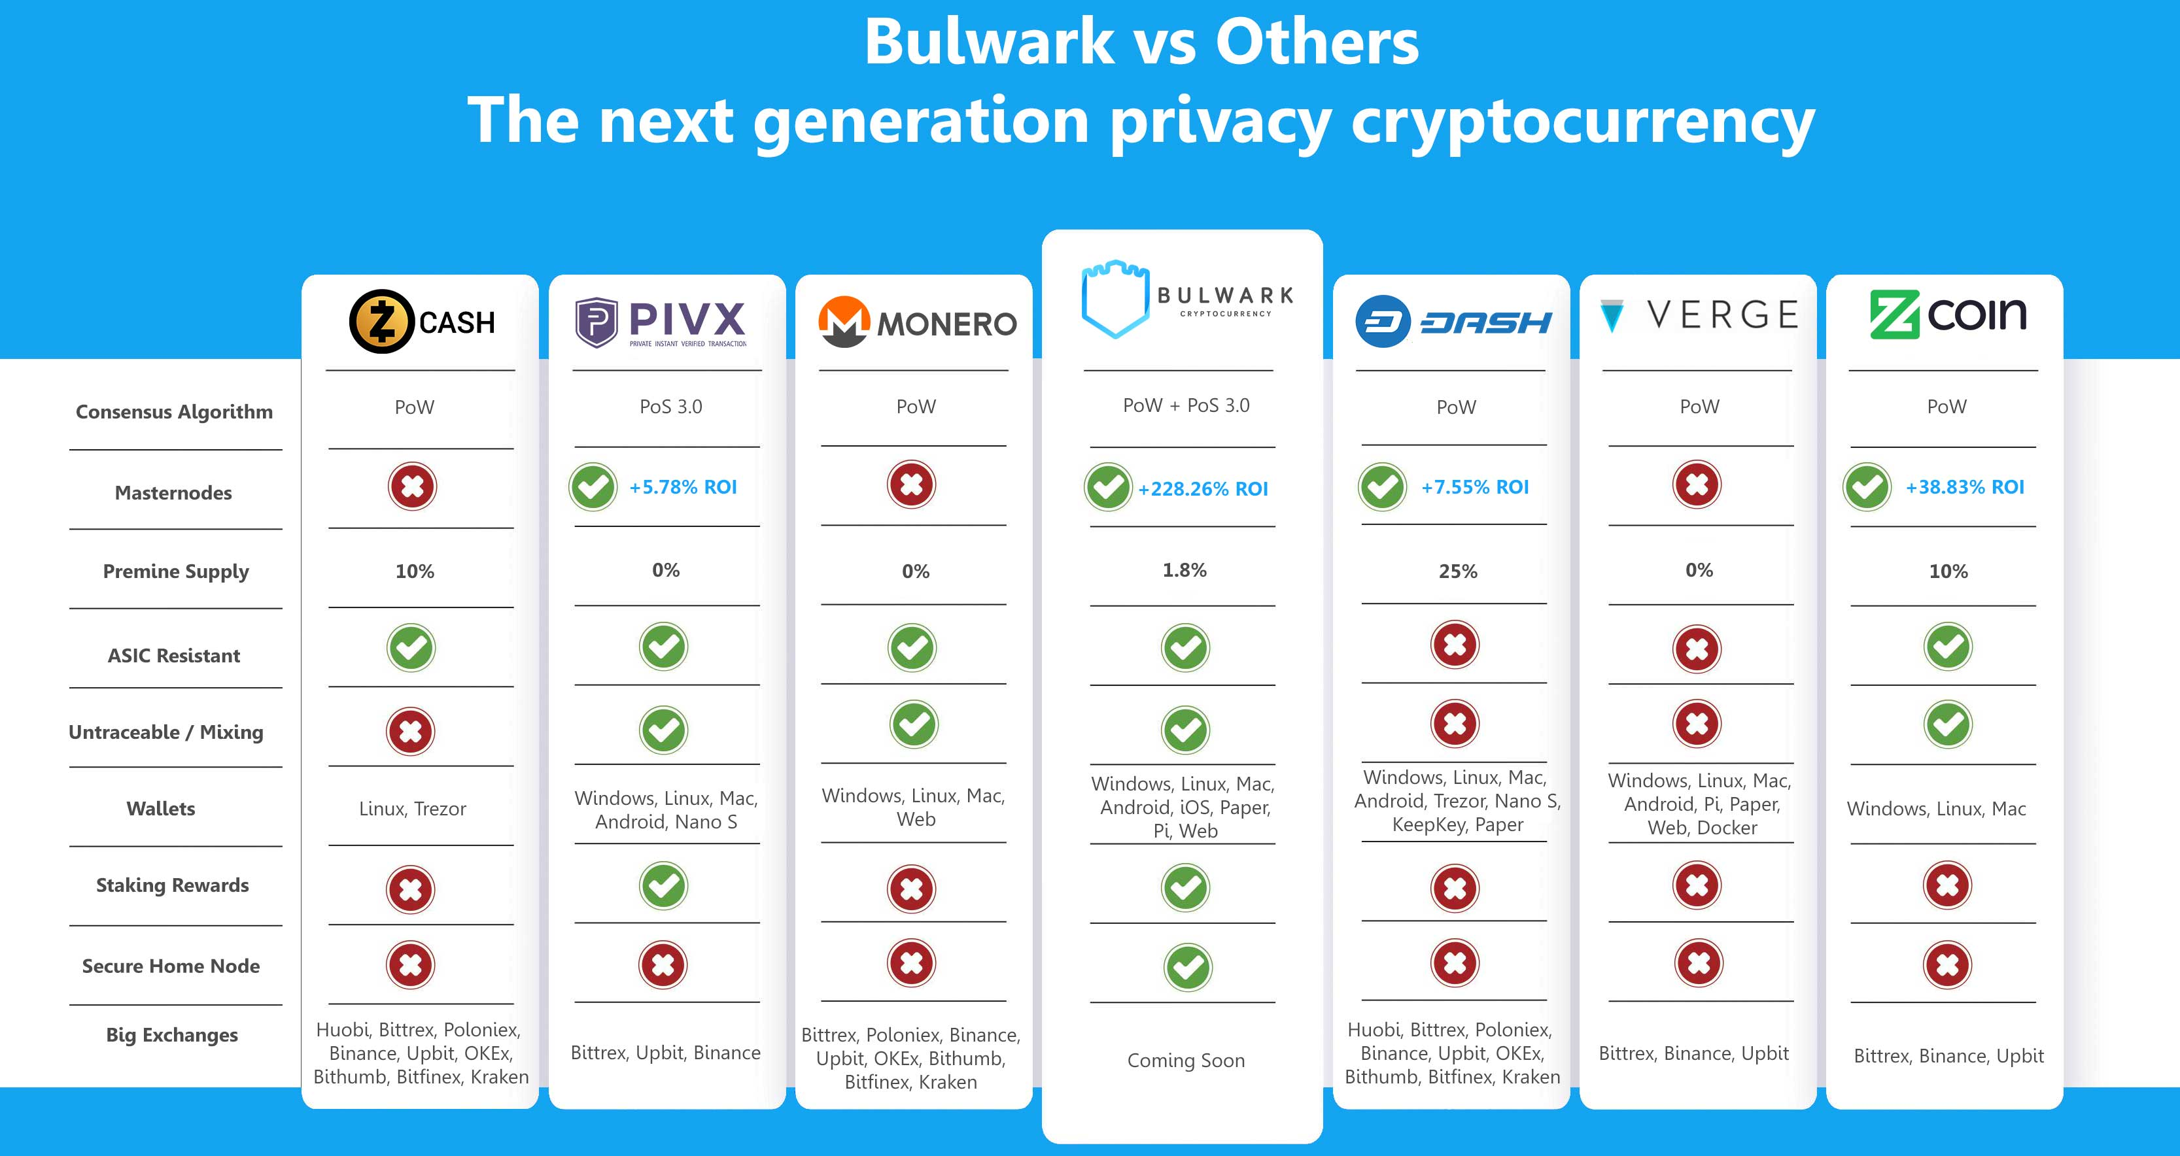
A Quick Note About Comparison Charts

Slide 19
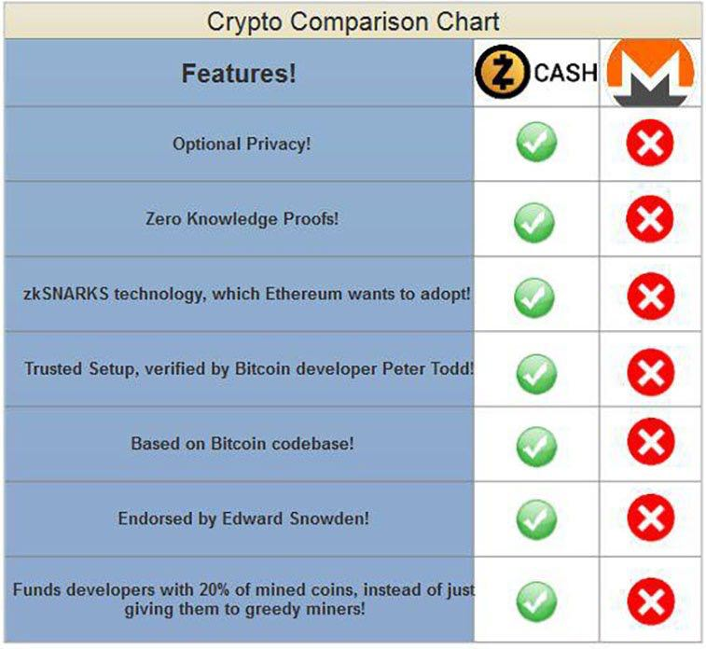
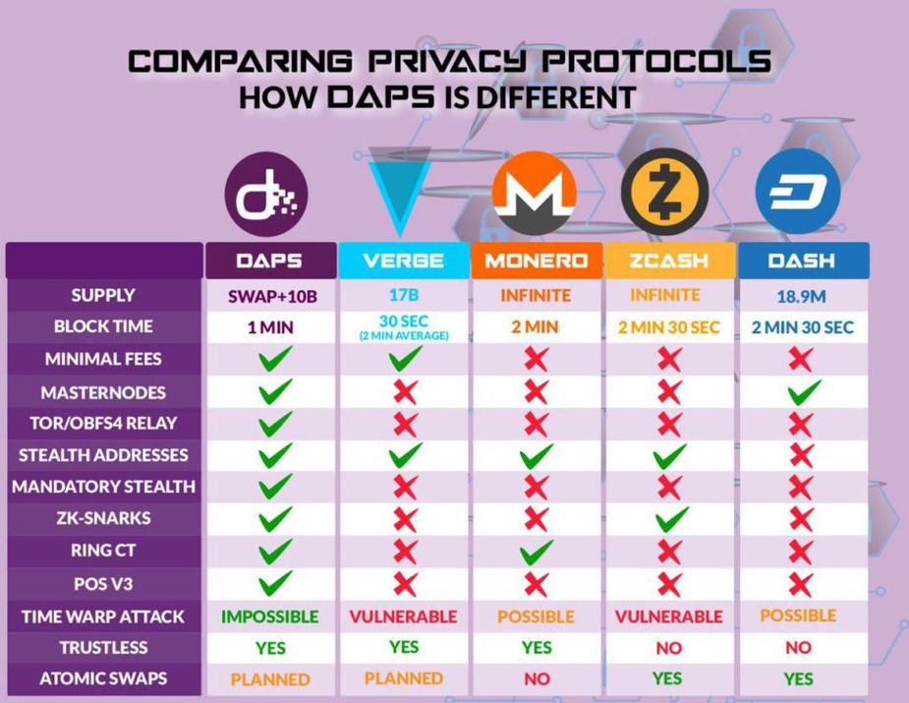
A Quick Note About Comparison Charts

Slide 20


Privacy Solutions to Consider
Source of Funds
Receiver
Amount
Transaction Size
Verification Time
Signing Time
Decent Protection
Protected
Protected
~2kB
Milliseconds
Milliseconds
Not Protected
Not Protected
Not Protected
~0.3kB
Milliseconds
Milliseconds
Protected
Protected
Protected
~1kB
Milliseconds
~2.3 seconds
Protected if Shielded
Not Protected*
Not Protected
~20kB*
Not Sure
~10 seconds

Slide 21
How Monero Works
SENDER
AMOUNT
TRANSACTION
BROADCAST
RECEIVER
ɱ
RING
SIGNATURES
RING CONFIDENTIAL
TRANSACTIONS (RINGCT)
KOVRI
(I2P ROUTER)
STEALTH
ADDRESSES
Notes:
Monero is different from a mixing service. It uses three technologies and a work-in-progress fourth technology to provide trustless privacy for all transactions. These technologies work together to protect different parts of a transaction. The sender is hidden with ring signatures. The amount is hidden with ring confidential transactions, or RingCT. The transaction broadcast is not currently hidden without extra steps, but Monero is working on Kovri, an I2P router, to hide this with no additional effort. The receiver is hidden with stealth addresses. All of these technologies will be addressed in this presentation.

Slide 22


Ring Signatures & RingCT
8 (Tx ID hng6iwfumwf8)
8 (Tx ID hng6iwfumwf8)
15 (Tx ID wn3f4diiijffwn)
1 (Tx ID e4hn4ifqyd5ed)
15 (Tx ID wn3f4diiijffwn)
2 (Tx ID eshgni5lsvnf74)
9 (Tx ID cb8vqfi8dfj65f)
16 (Tx ID 5 f8wnfdmmii)
3 (Tx ID wb4f5hdfdicnd)
10 (Tx ID fnidmfnu3dm8)
17 (Tx ID h8fn5mdfi4w)
4 (Tx ID nh5nogsefwjw)
11 (Tx ID twv8mf8dnfas)
11 (Tx ID twv8mf8dnfas)
18 (Tx ID n48gfwmfdki)
BLOCKCHAIN
18 (Tx ID n48gfwmfdki)
5 (Tx ID fgwinw3fwtk54)
5 (Tx ID fgwinw3fwtk54)
12 (Tx ID h5o8mfdngkd)
19 (Tx ID fnidmnfdsam)
6 (Tx ID ybwnng8nengf)
13 (Tx ID 7nr8mrjffijdtm)
20 (Tx ID t4vn8lf8djer4)
7 (Tx ID e4bgn8flwwrj8)
14 (Tx ID f8n8madkrjmd)
21 (Tx ID 4f5f8njdoam4)
21 (Tx ID 4f5f8njdoam4)
Notes:
Start by imagining the entire money supply of Euros or Dollars, all in one place. This supply is divided into different notes or bills of a certain value (10, 20, 50. etc). Monero is basically the same. The whole Monero money supply is contained in different outputs, each with a certain amount of Monero. One could be 0.01 XMR, and another could be 1000 XMR. Now imagine this red highlighted one is an output that you control. You have the ability to spend it, and it’s as if you had physical money in your wallet. When you make a Monero transaction, you want to hide what the origin of the funds are, since Monero tries to prevent the blacklisting of certain coins. Your wallet software will select other inputs from those available. These will be controlled by other people. You will appear to spend these amounts, along with your own, even without communicating with the real owner. Thus, by making it seem as if your red input is spent along with the other blue ones highlighted here, no one but you (the sender) knows what the origin of the money is.

Slide 23
Ring Signatures & RingCT
INPUTS
5
8
11
Min Ringsize = 11
13
15
18
21
key image
Notes:
The ring signature is just the process of taking your red (real) input, the blue ones (decoys), and making it seem as if they are all spent simultaneously. An outside observer does not know which is the real one, since they are all possible. In this example, the ringsize is 7, meaning that 7 total inputs (including your own) are used. As of August 2017, the minimum allowed by the network is 7. In September 2017, the minimum is expected to be increased to 5 or greater, since more decoys allows for better privacy. The key image is generated for the real input used. Nodes and miners can use this to verify that a real input is actually being spent, but they still do not know which input is real. The key image prevents attackers from spending money more than once or from spending money that does not exist.

Slide 24
Ring Signatures & RingCT
INPUTS
Pedersen commitment
rCT = x*G + a*H(G)
5 (Tx ID fgwinw3fwtk54)
5
Random Number
Actual Amount
8 (Tx ID hng6iwfumwf8)
8
11 (Tx ID twv8mf8dnfas)
11
RingCT ring signature, signs difference between commitments
Min Ringsize = 11
13
13 (Tx ID 7nr8mrjffijdtm)
15 (Tx ID wn3f4diiijffwn)
15
? XMR
18 (Tx ID n48gfwmfdki)
18
Commitment public key
21 (Tx ID 4f5f8njdoam4)
21
key image
Notes:
For each of these inputs, a fraction is used according to a Pedersen commitment. It is not important to remember any important math on an introductory level, but know that the sender in a transaction spends a proportion of the input that only the sender knows. The commitment itself consists of two parts: 1) the actual amount a, which is hidden by adding 2) a random number x. Since no one knows what the random number is except the sender, an outside observer does not know how much is actually being spent. This commitment will be evaluated among the inputs and outputs, to make sure the same value is generated on both sides of the transaction. A range proof prevents the sender from using a different random number for the input and output set. Finally, the transaction is fully signed as a RingCT ring signature, resulting in an unknown amount of Monero sent to the receiver or receivers. As an output, the commitment public key is published to allow the network to audit the math done behind the Pedersen commitment.

Slide 25
Ring Signatures & RingCT
Notes:
For each of these inputs, a fraction is used according to a Pedersen commitment. It is not important to remember any important math on an introductory level, but know that the sender in a transaction spends a proportion of the input that only the sender knows. The commitment itself consists of two parts: 1) the actual amount a, which is hidden by adding 2) a random number x. Since no one knows what the random number is except the sender, an outside observer does not know how much is actually being spent. This commitment will be evaluated among the inputs and outputs, to make sure the same value is generated on both sides of the transaction. A range proof prevents the sender from using a different random number for the input and output set. Finally, the transaction is fully signed as a RingCT ring signature, resulting in an unknown amount of Monero sent to the receiver or receivers. As an output, the commitment public key is published to allow the network to audit the math done behind the Pedersen commitment.

Slide 26


Ring Signatures & RingCT
INPUTS
5
A to B
B to C
C to D
8
Older
Newer
11
15
18
Input previously seen in this transaction, but unsure if actually
used to send money or if used as a decoy in a ring signature.
21
Notes:
Now that we have looked into how the inputs for a single transaction are hidden among others, it can be helpful to look at how inputs are used over time. The same inputs as before are on the left. The history for the red one is shown on a hypothetical blockchain on the right. The older blocks are on the left, and the newer blocks are on the right. The blocks highlighted red signify to the times that this input was included. There are three ways this could happen:
It is new money from a Coinbase transaction. This is known to everyone on the network. They do not know what address controls it.
The input was actually spent by the real controller
The input was borrowed an used as a decoy in another transaction
Since there is no way to differentiate between 2 and 3, there is no way of knowing whether an input is actually spent, even if it appears in a specific block.

Slide 27
Stealth Addresses
INPUTS
OUTPUTS
Commitment public key
Back to Sender
ey5f8ne58nh5nogsefwjw
? XMR
58fmd8jhybwnng8nengf
To Receiver
Fee (included in coinbase)
Notes:
Finally, Monero hides where the money is going to with stealth addresses. Instead of sending money directly to an address, Monero is essentially locked in a container. Every account must search each of these containers to know which is for them, but only one account can open the container. Furthermore, no one else knows who the container is for. This is how stealth addresses work on a very basic level. Outside observers don’t even know these outputs from a single transaction go to one person. They could go to several people. In this example, the red ones go to the receiver, and the blue ones come back to the sender as change. This change can be used to break up large inputs (say they have 100 XMR but only want to send 10 XMR to someone. Then, they can send 90 XMR back as change).

Slide 28
Summary
OUTSIDER VIEW
5
8
11
5hfnq835hng6iwfumwf8
13
? XMR
3348dqnqcb8vqfi8dfj65f
15
Commitment public key
18
21
Outsiders know the fee amount but not which input it came from
Notes:
In summary, for any given transaction, Monero is sent from an ambiguous source, from which an unknown amount is committed and thus an unknown amount is sent, to an unknown receiver or set of receivers. As you can see, all information stored on the blockchain is obfuscated by mandate.

Slide 29
Summary
INSIDER VIEW
5
8
11
5hfnq835hng6iwfumwf8
13
? XMR
3348dqnqcb8vqfi8dfj65f
15
Commitment public key
18
21
Notes:
In summary, for any given transaction, Monero is sent from an ambiguous source, from which an unknown amount is committed and thus an unknown amount is sent, to an unknown receiver or set of receivers. As you can see, all information stored on the blockchain is obfuscated by mandate.

Slide 30
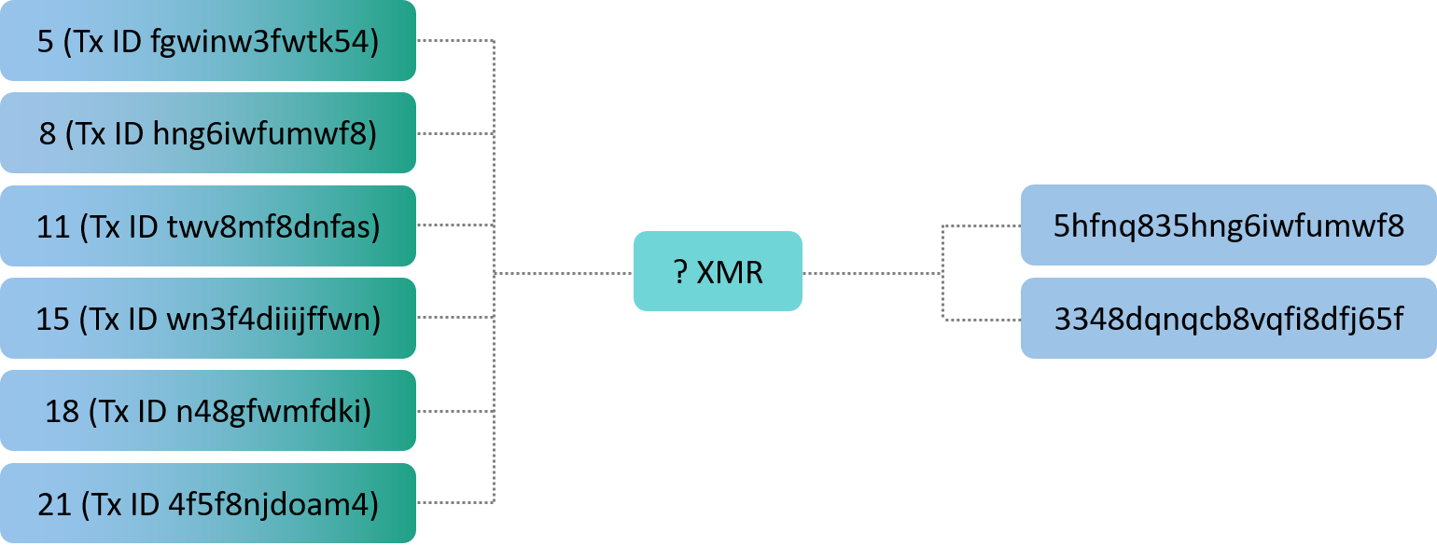
Things Get Complicated Quickly

Slide 31
Ask the Following
How good is the theoretical best?
How is it currently used?
What metadata is leaked?
What are the possible attack vectors?
How realistic is it to use?
Is there any research explaining why this technology works? How good and verbose is it?
Are they open to discussing the limitations?
Are they acting in good or bad faith?

Slide 32
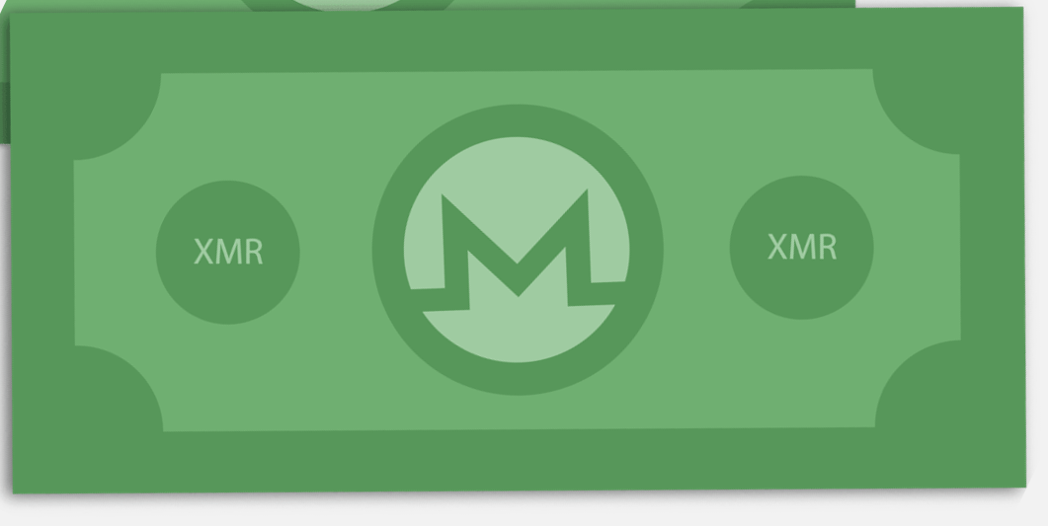
Fungibility
=
TAINTED
≠

Slide 33
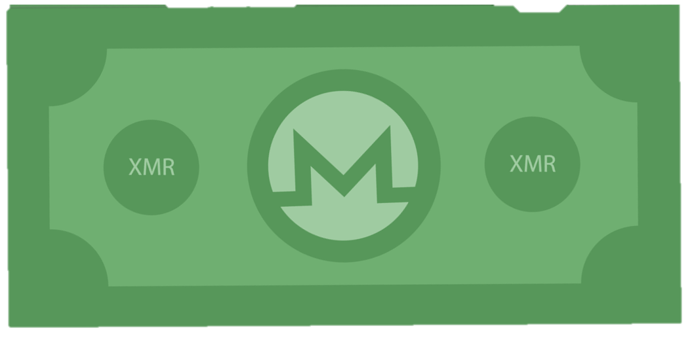








Fungibility

Slide 34



Summary

Slide 35



Thank You!
MAGICgrants.org
u/SamsungGalaxyPlayer
@JEhrenhofer
justin@ehrenhofer.org
5137 9F1B A7FC 2D05

